Slide 1
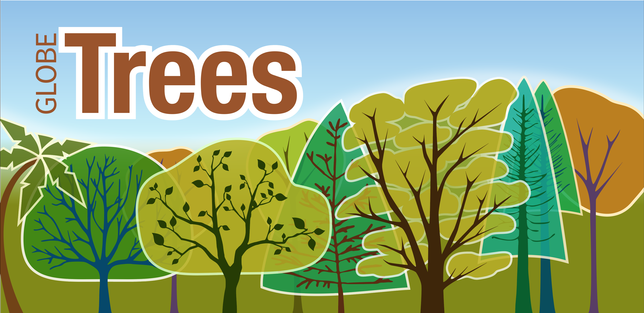
The Effects of Native Tree Species on Ambient Air and Surface Temperatures in Southeastern Michigan
Itidal Bazzi and Zeina Jebara
Crestwood High - Dearborn Heights, MI
Abstract
Gathering data is essential when developing strategies to improve our understanding of the impact urban trees potentially have in helping to mitigate the urban heat island effect. This research project was conducted near Crestwood High School in Dearborn Heights, Michigan; a relatively small suburban city approximately 17.2 miles away from the urban center of Detroit. Native tree species are more acclimated to local and regional conditions as they have evolved in this region since the last ice age. Native trees are also important to local wildlife because they also evolved an ecological interdependence. Using GLOBE protocols - temperature data, tree heights, and circumferences were collected from under a tree’s canopy and also outside of its canopy during the 2019 summer. Commonly planted deciduous native tree species were chosen to investigate the shading effect they had on both surface and ambient air temperatures.
The GLOBE Observer App for trees was used to obtain tree height and circumference and a Pasco weather station was used to record weather data. Weather data was exported to an Excel spreadsheet for analysis. All of the data was entered through the GLOBE data entry portal. Preliminary analysis showed that of the trees sampled, basswoods (Tilia americana) had the largest ability to reduce surface and air temperatures while the red maples (Acer rubrum) appeared to have a smaller effect. This research seems to suggest that planting a greater proportion of basswoods in urban plantings might help to mitigate the warming effect that many anthropogenic structures and surfaces have in cities. Although most trees have the ability to reduce temperatures, this research sought to determine if some native tree species were a better choice than others. Further research needs to be conducted to evaluate other native tree species suitable for city plantings.

Slide 2
Research Questions
• How do different native tree species affect air and surface temperatures?
• Which native tree species planted in urban areas are most effective at reducing urban temperatures during the summer? Which tree is the least effective?
• Does overall tree form and leaf shape affect the ability of a tree to reduce temperatures?
These driving questions were used to focus and lead our investigation seeking to find optimal solutions for choosing trees to help mitigate urban heating.
Itidal Bazzi and Zeina Jebara

Slide 3
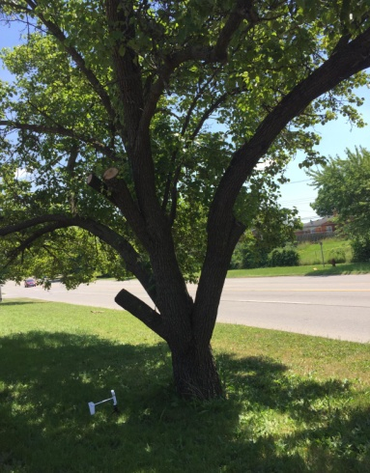
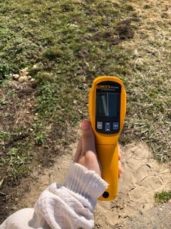
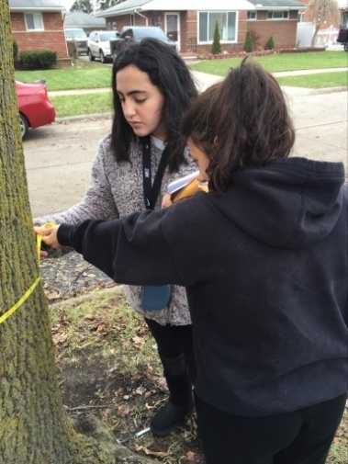
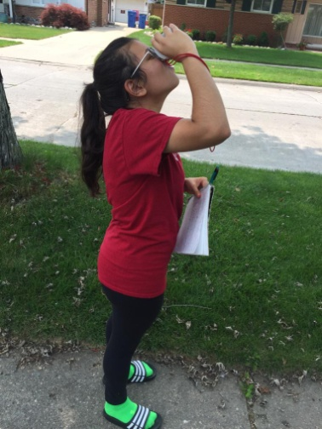
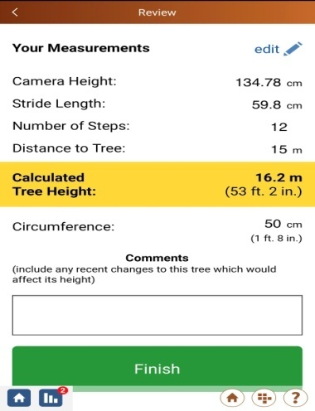
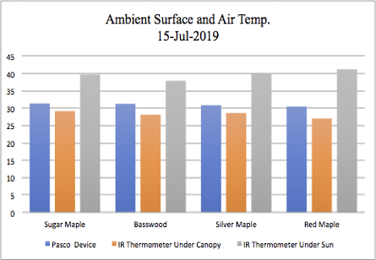
Methods
Set up a PASCO device, connect it to sparkvue application, and let it run for ten minutes.
Take 9 recordings of surface data both under the canopy and in the sun
Collect the DBH of the trees from the breast of the tree 1.37 meters from the base
Measure height using a suunto clinometer three times per partner
Figure out average temperatures from the infrared thermometer and PASCO weather device and graph the data.
Measure the height using the globe observer app and submit into the GLOBE database.
Itidal Bazzi and Zeina Jebara

Slide 4
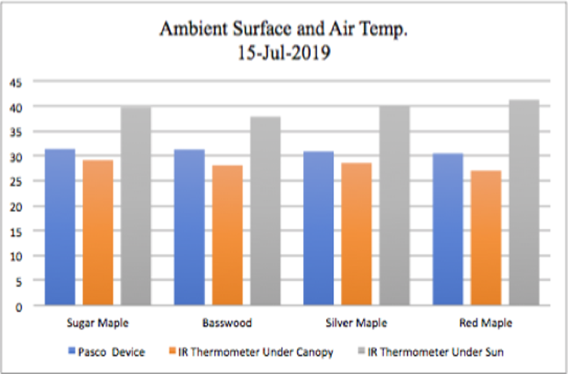
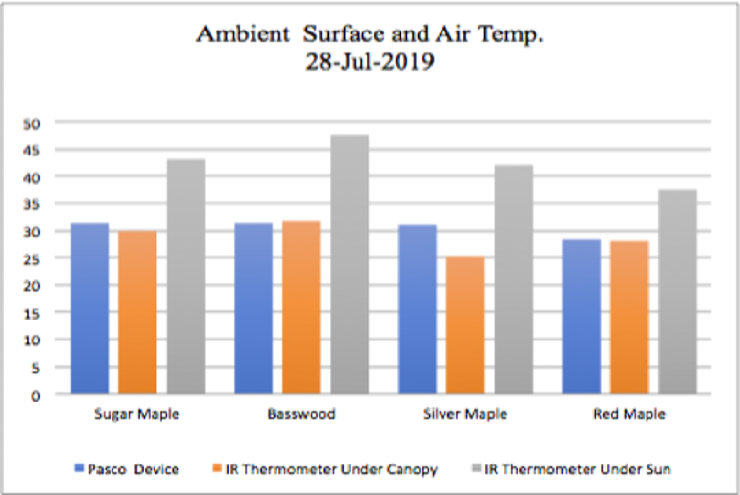
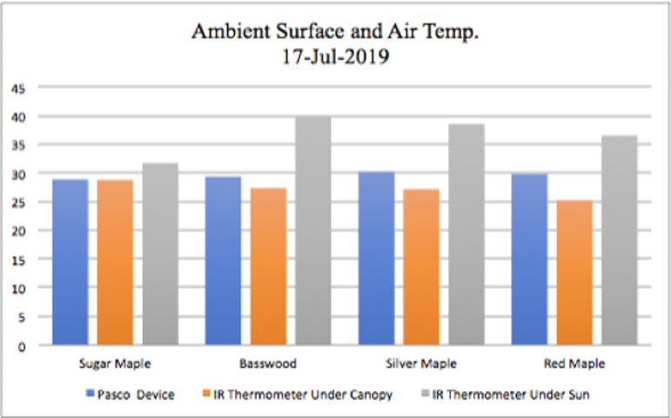
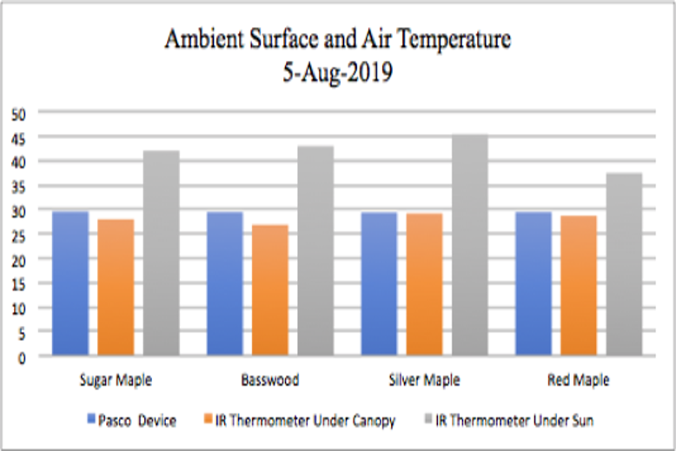
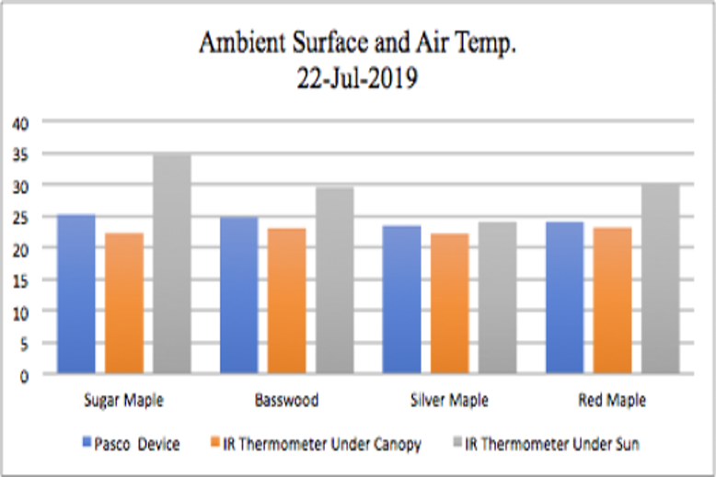
Results
Figure 1: Figure one visualized the data taken on July 15, 2019. It showed that the Red Maple had the largest effect.
Figure 4: In figure 4, as it was one of the coolest it was shown that the tree having the most effect was Sugar Maple, creating the correlation that the taller in height the tree the larger the change in surface and air temperature when weather is cooler. ​
Figure 2: Figure two showed the Basswood had the greatest effect while only having a 2-day difference from Figure 1
Figure 5: All data was consecutively collected through the PASCO device and Auto-Pro Raytek IR thermometer. Basswood had the largest affect in figure 5.
Figure 3: Figure 3 visualizes the effects in either heat reduction or gain. It was known that Sugar Maple had the largest affect in figure 3. ​
Itidal Bazzi and Zeina Jebara

Slide 5
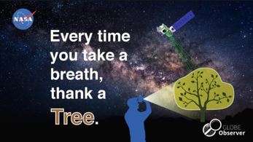
Result Averages
Acer rubrum – Cooling of an average of 9.161 degrees Celsius.
Acer saccharum – Cooling of an average of a 9.74 degree Celsius
Acer saccharinum – Cooling of an average of 10.295 degrees Celsius
Tilia Americana – Cooling of an average of 11.214 degrees Celsius
Itidal Bazzi and Zeina Jebara

Slide 6
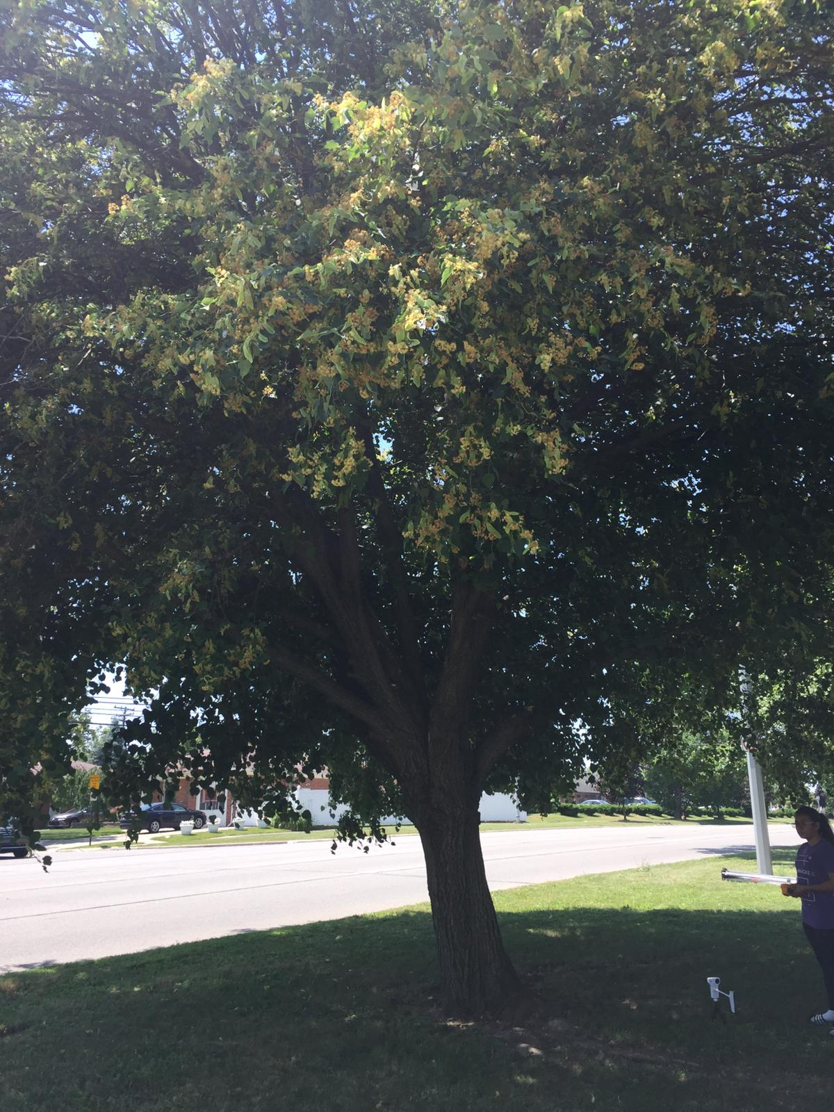
Discussion
The Tilia Americana had the largest effect on the temperatures with an average change of 10.3 degrees Celsius when using a PASCO weather device and a 12.1-degree Celsius difference when using an infrared thermometer.
A research study done by Mohammad A. Rahman, Astrid Moser, Anna Gold, Thomas Rötzer, Stephan Pauleit stated that the larger trees with a higher canopy volume tended to show a decrease in soil temperatures.
Compared to the data, although the largest tree didn’t have the greatest effect, it was shown that the red maple, which was the smallest, performed worst.
The results supported one of our hypotheses as the smaller trees would be the worst at providing cooling against the urban heat island effect.
Itidal Bazzi and Zeina Jebara

Slide 7
Conclusion
Through further analysis of the data, it was figured that the Tilia Americana tree species provided the largest effect on cooling with an average cooling of 11.214 degrees Celsius between surface temperatures and air temperatures taken by the PASCO wireless weather device.
The Acer rubrum provided the least cooling with an average of 9.161 degrees Celsius. The Acer saccharum provided an average of a 9.74 degree Celsius cool down while the Acer saccharinum provided an average of 10.295 degrees Celsius.
To follow up this research, a plan could be taken into effect to plant more of the Tilia Americana tree species in order to further reduce the effect of urban heating and increase cooling provided by the trees.
In the future, it is planned to continue this research by gathering more air and surface temperatures as well as using new methods with the current ones.
In order to create a more valid conclusion we would need to test on a larger quantity of trees since only four were tested in this project as well as study canopy size for a more accurate prediction of cooling potential.
Itidal Bazzi and Zeina Jebara

Slide 8
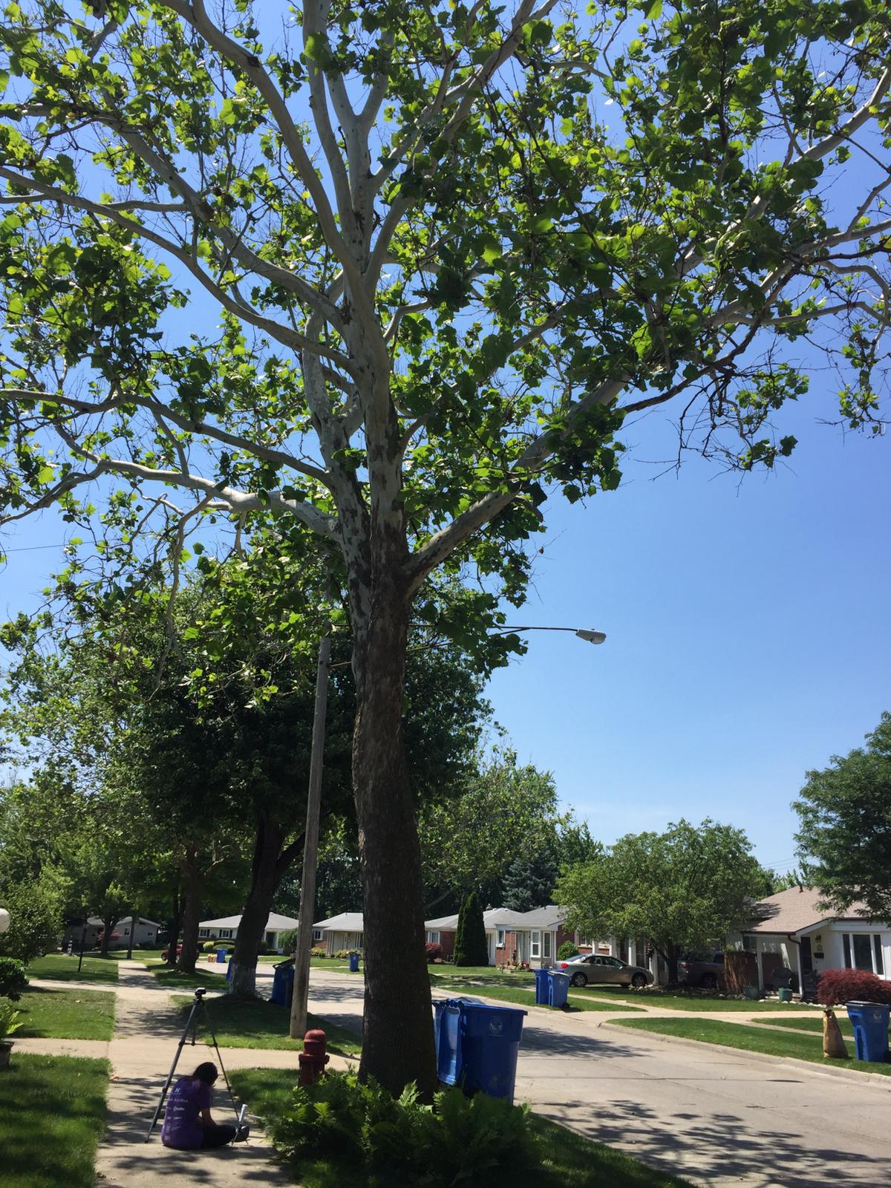
Measurement Implications / Significance
By going through with this investigation, it is possible to view which trees perform to the highest of their ability in reducing the urban heat island effect.
Working with students from the Princess Chulabhorn Science High School in Thailand to also spread the research into a wider area of study.
Itidal Bazzi and Zeina Jebara

Slide 9
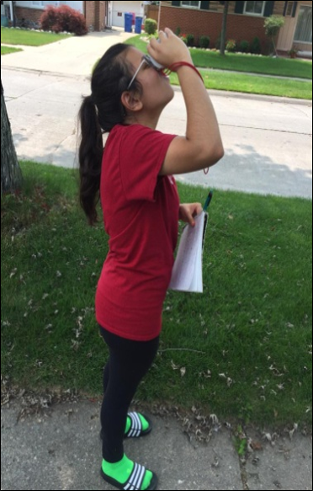
Forthcoming Plans
Measurement Limitations​
Continuing to focus on the same concept of working within urban neighborhoods, but still expand the parameters in which we would compare with our GLOBE school in Thailand.
Also expanding the weather parameters used within the PASCO device and add dew point plus relative humidity to the project.
Also broadening the research time frame for a wider variety of results.
Hopefully including a better study of canopy affects by using AREN protocols.
Due to the fact that the trees suitable to the research were clustered together and there weren’t too many trees other than those. ​
Globe observer app not being as accurate as possible​
Itidal Bazzi and Zeina Jebara

Slide 10
Acknowledgments
Bibliography​
We’d like to thank the group of students at the Princess Chulabhorn Science High School in Thailand for being extremely helpful and willing to communicate with us, so we’d be able to expand our project into broader concepts. Most especially, we’d like to thank our teacher, Mrs. Diana Johns, for assisting us throughout this project and helping to supply the necessary materials, with whom we would not be able to accomplish as much as we had without her.
Loughner, Christopher P. “Roles of Urban Tree Canopy and Buildings in Urban Heat Island Effects: Parameterization and Preliminary Results.” Roles of Urban Tree Canopy and Buildings in Urban Heat Island Effects: Parameterization and Preliminary Results: Journal of Applied Meteorology and Climatology: Vol 51, No 10, journals.ametsoc.org/doi/full/10.1175/JAMC-D-11-0228.1. ​
What Tree Is That? Online. (n.d.). Retrieved from http://www.arborday.org/trees/whattree/whatTree.cfm?ItemID=E6A
Itidal Bazzi and Zeina Jebara

